Slide 1
Who Will be a Client?
Predicting bank term deposit subscription with different features
Team 17
Sepehr Foroughi Shafiei
Hao Zhao
Ian Pegg
Harshita Krishna
Notes:
We are gonna talk about how banks can pick customers who are more likely to subscribe to their term deposit plans.

Slide 2


Motivation
Have you ever wondered how banks pick their customers to make cold calls?

Slide 3
An Interesting question

Slide 4

How can we take calls from this

Slide 5

to this?

Slide 6
Methodology
Intuitively choose features that banks can use to pick customers.
Perform Analysis.
Verify predictions using random forest.

Slide 7
The Dataset
Bank Marketing Data Set [1] - UC Irvine’s machine learning repository
Collected between May 2008 to November 2010
41188 samples and 20 features

Slide 8
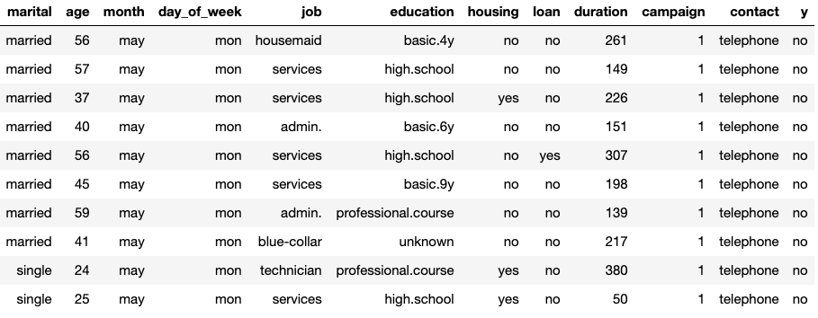
Direct marketing campaigns of a Portuguese banking institution

Slide 9
Which factors contribute to the decision of subscribing to the term deposit?
Marital Status
Age
Day of the week
Month

Slide 10
Impact of Marital status

Slide 11
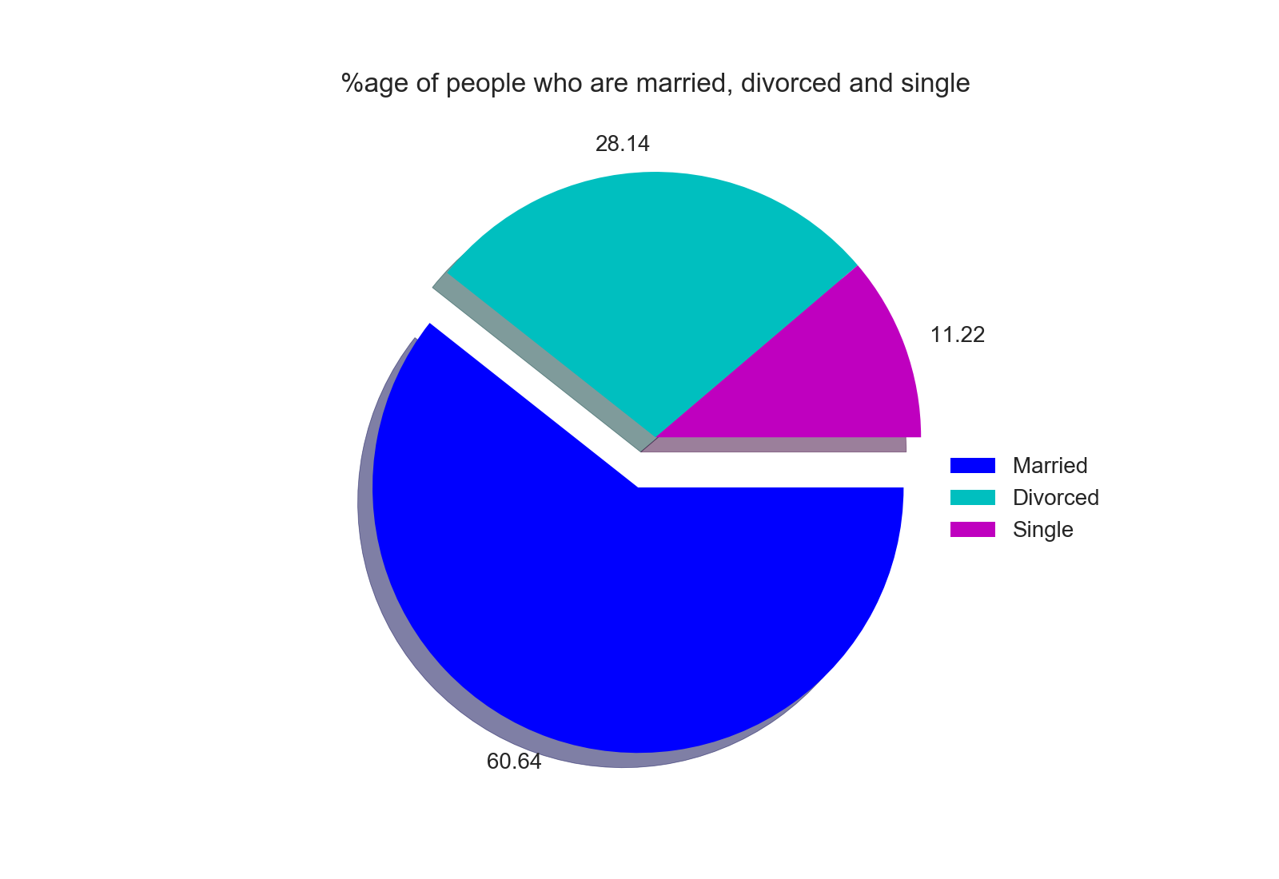
How does the population fare in terms of marital status?

Slide 12
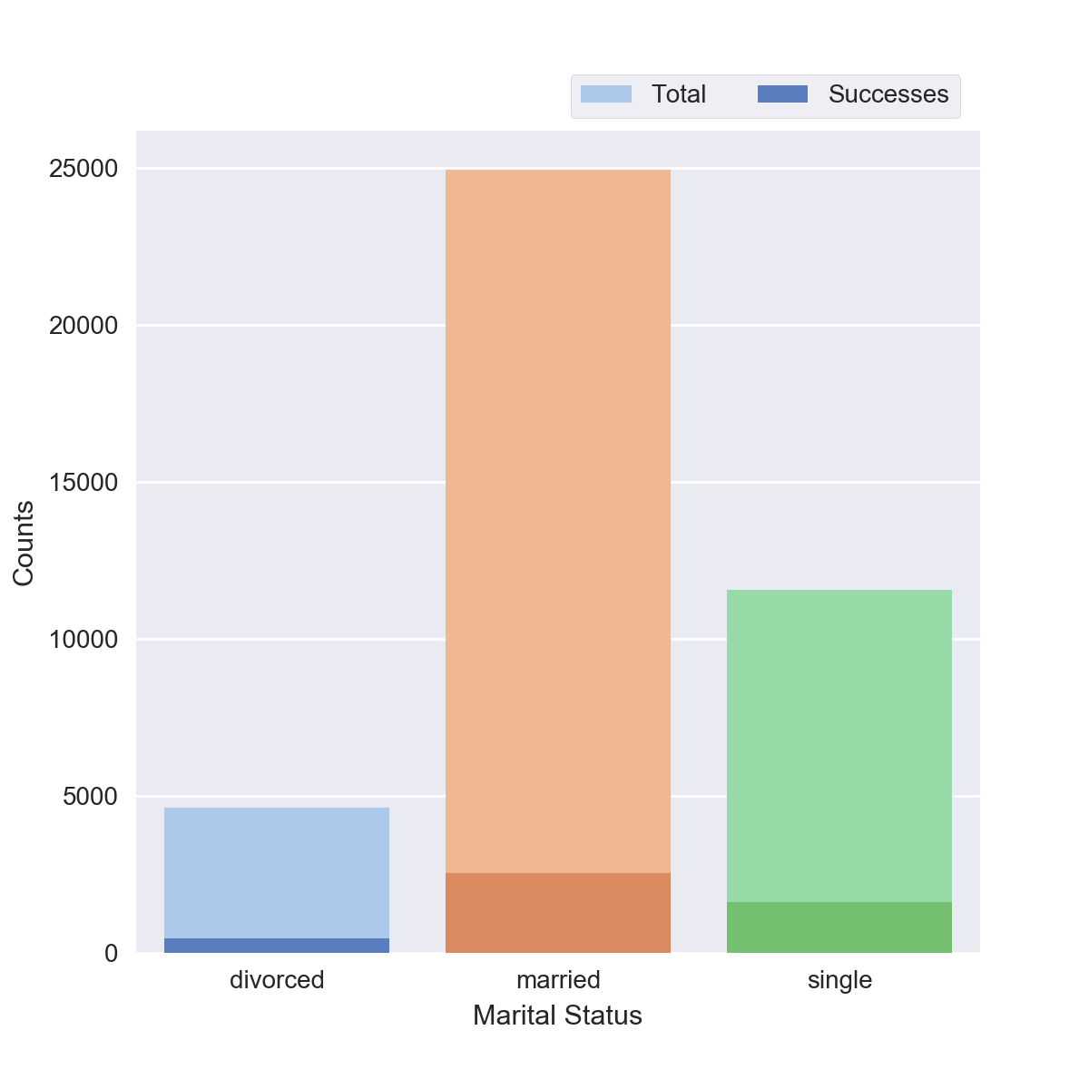
Number of calls vs people contacted based on marital status
Conversion rate for married people is low.
Singles contacted almost double the number of divorced contacted.
Conversion rate for singles more than that for divorced.

Slide 13
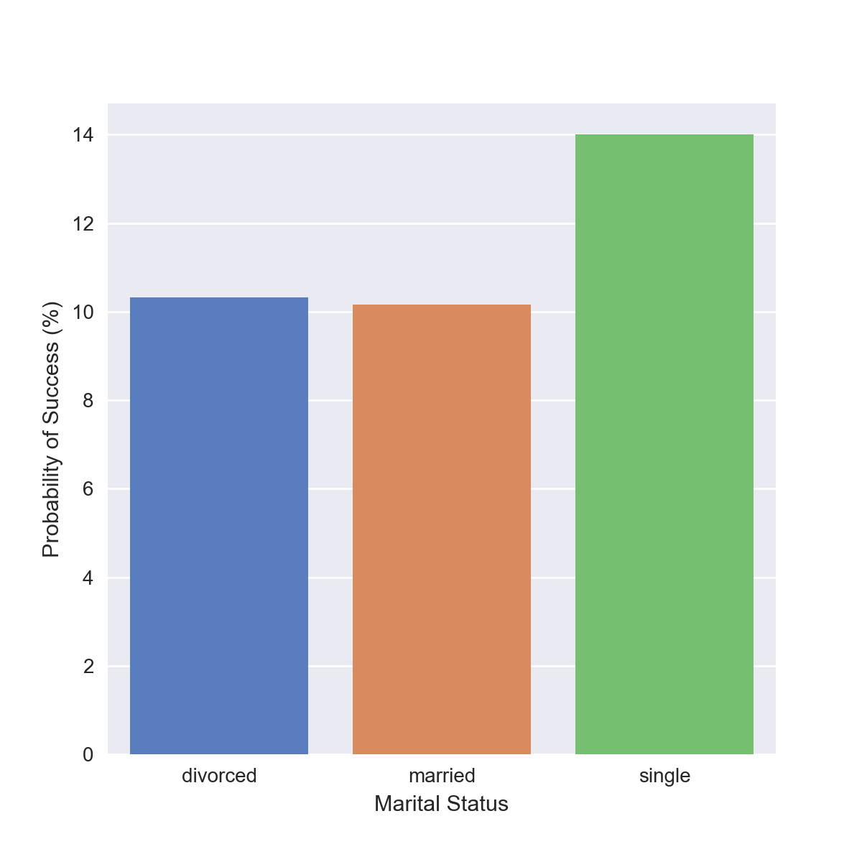
Probability that people of a particular marital status subscribe to the term deposit
Probability of success for married and divorced look similar.
Probability of success for single people is the highest.
Notes:
Probably because they have less liabilities and responsibilities financially

Slide 14
Month Analysis

Slide 15
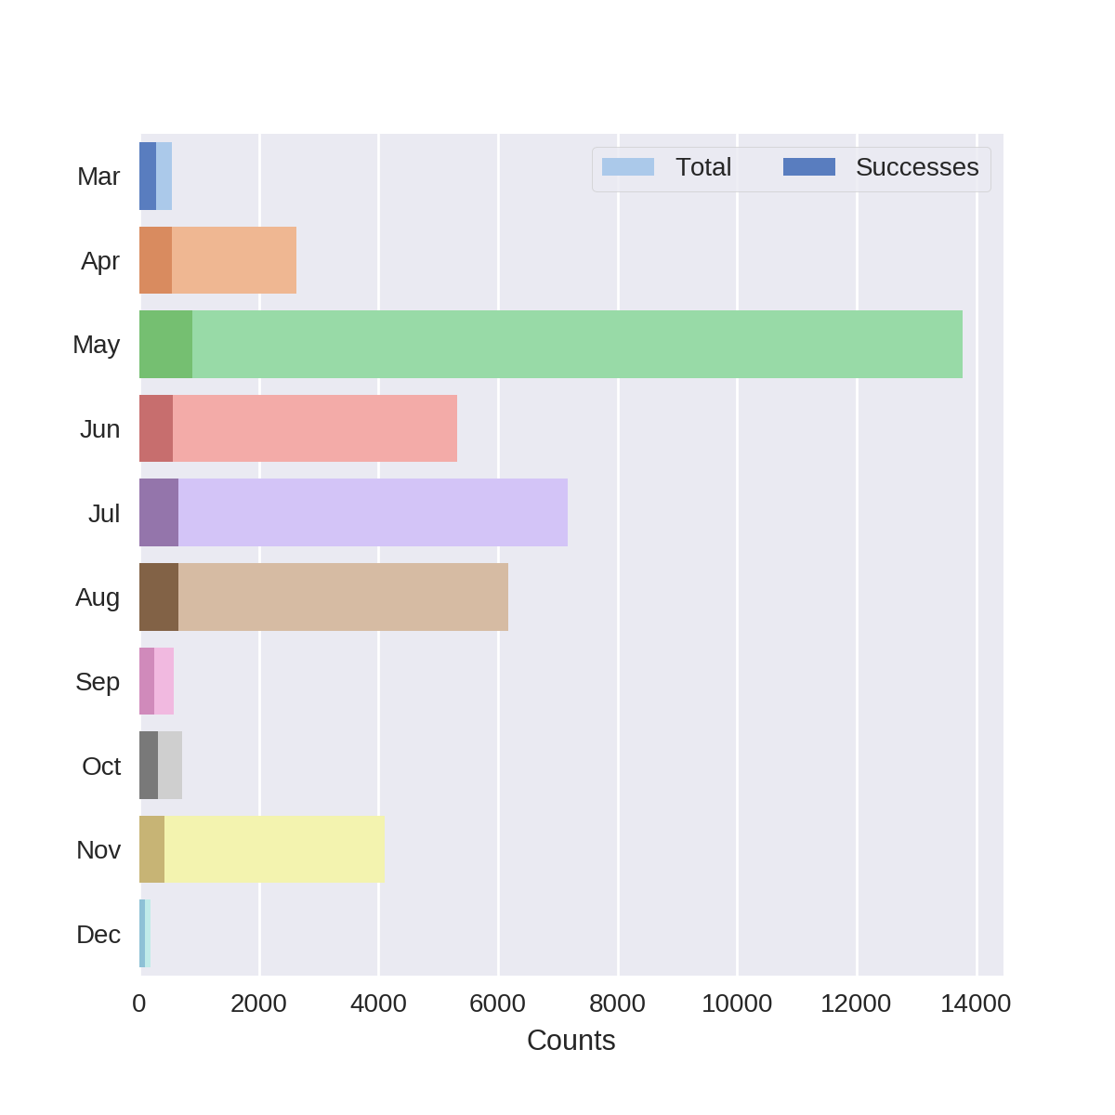
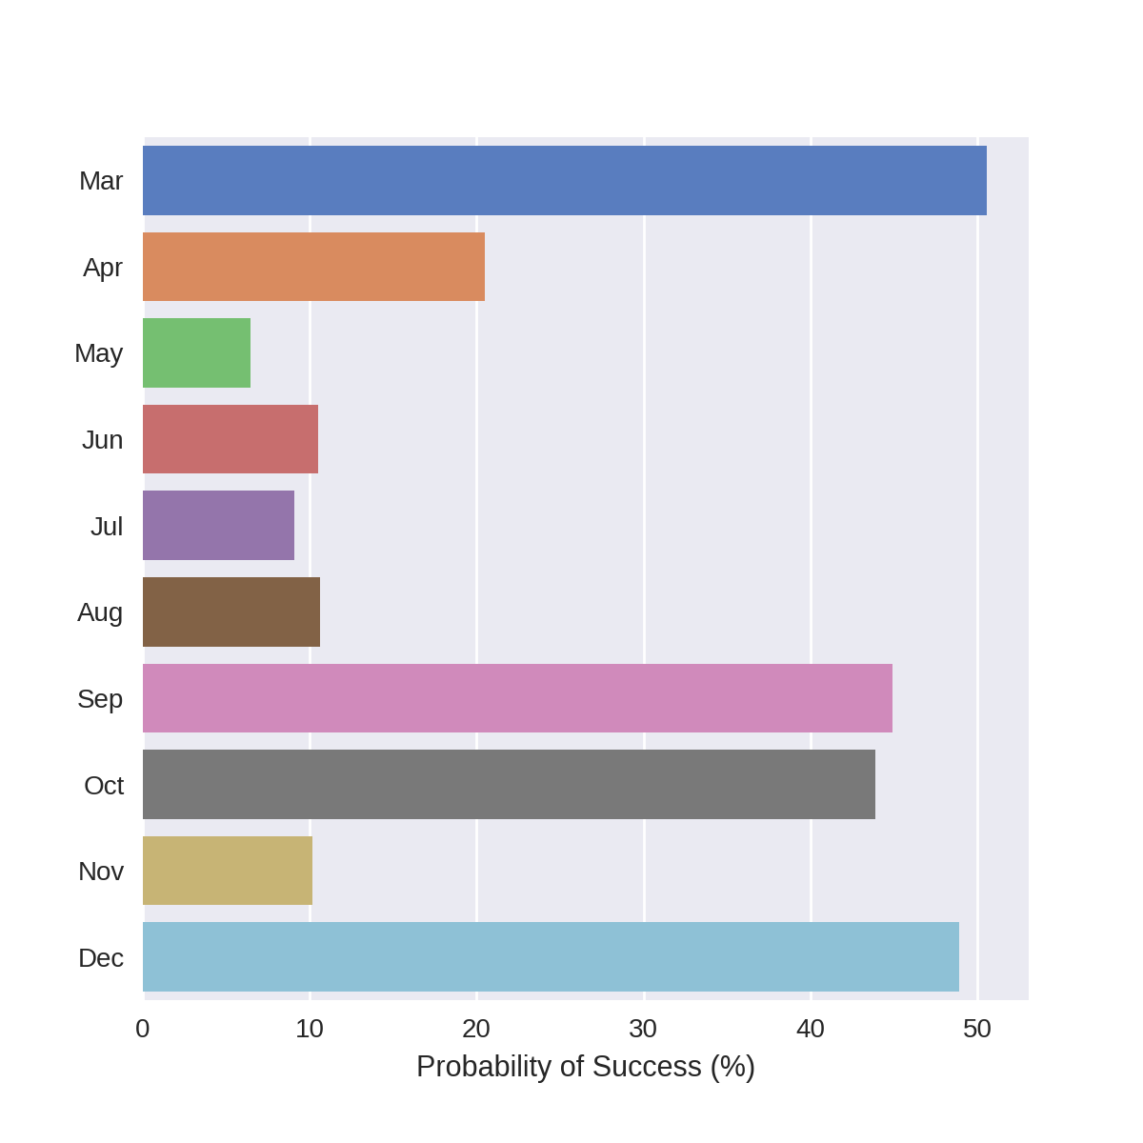
Month
Number of Calls by Month
Probability of Success by Month

Slide 16
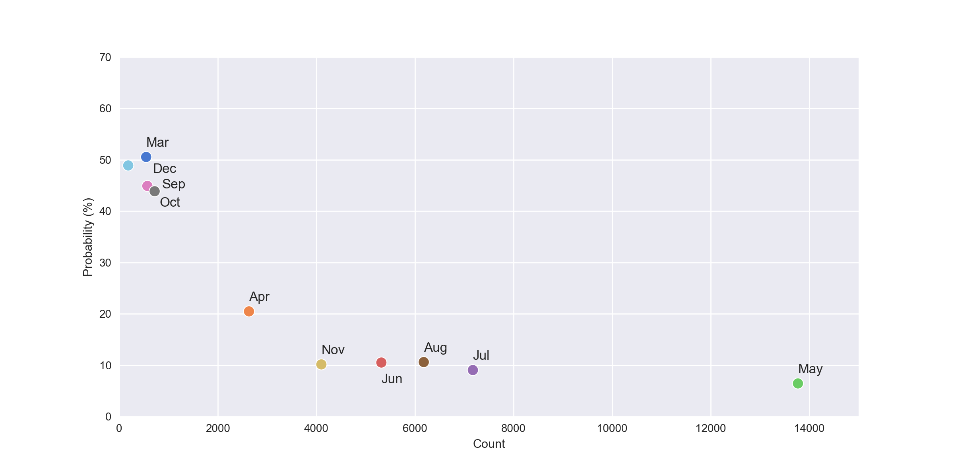
Month
Probability of success vs. Number of Calls by Month

Slide 17
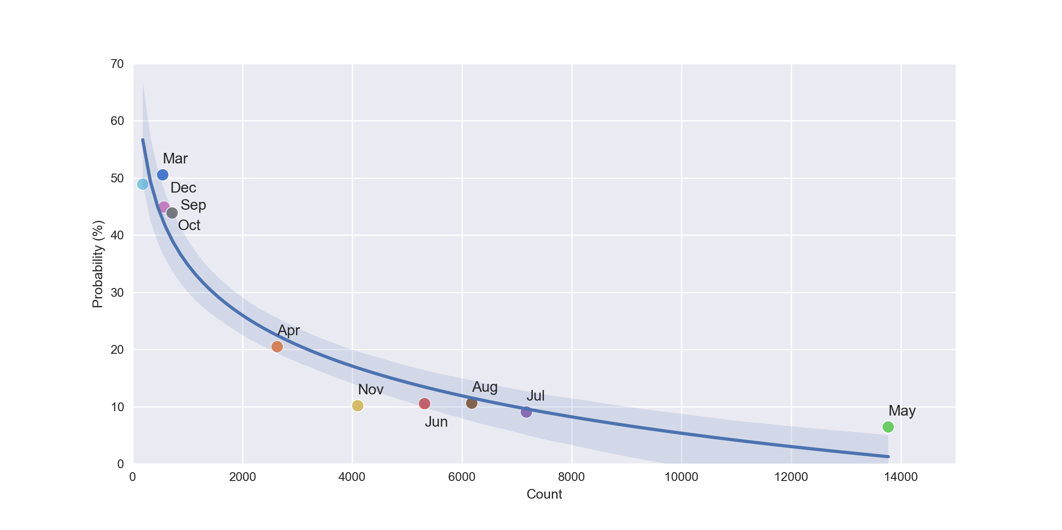
Month
Probability of success vs. Number of Calls by Month

Slide 18
Month
Probability of success vs. Number of Calls by Month
May had the most calls, but also the lowest chance of success

Slide 19
Month
Probability of success vs. Number of Calls by Month
March, September, October and November had the fewest calls, and the highest probability of success

Slide 20
Month
Probability of success vs. Number of Calls by Month
We can’t treat month as a predictor of success

Slide 21
Weekday Analysis

Slide 22
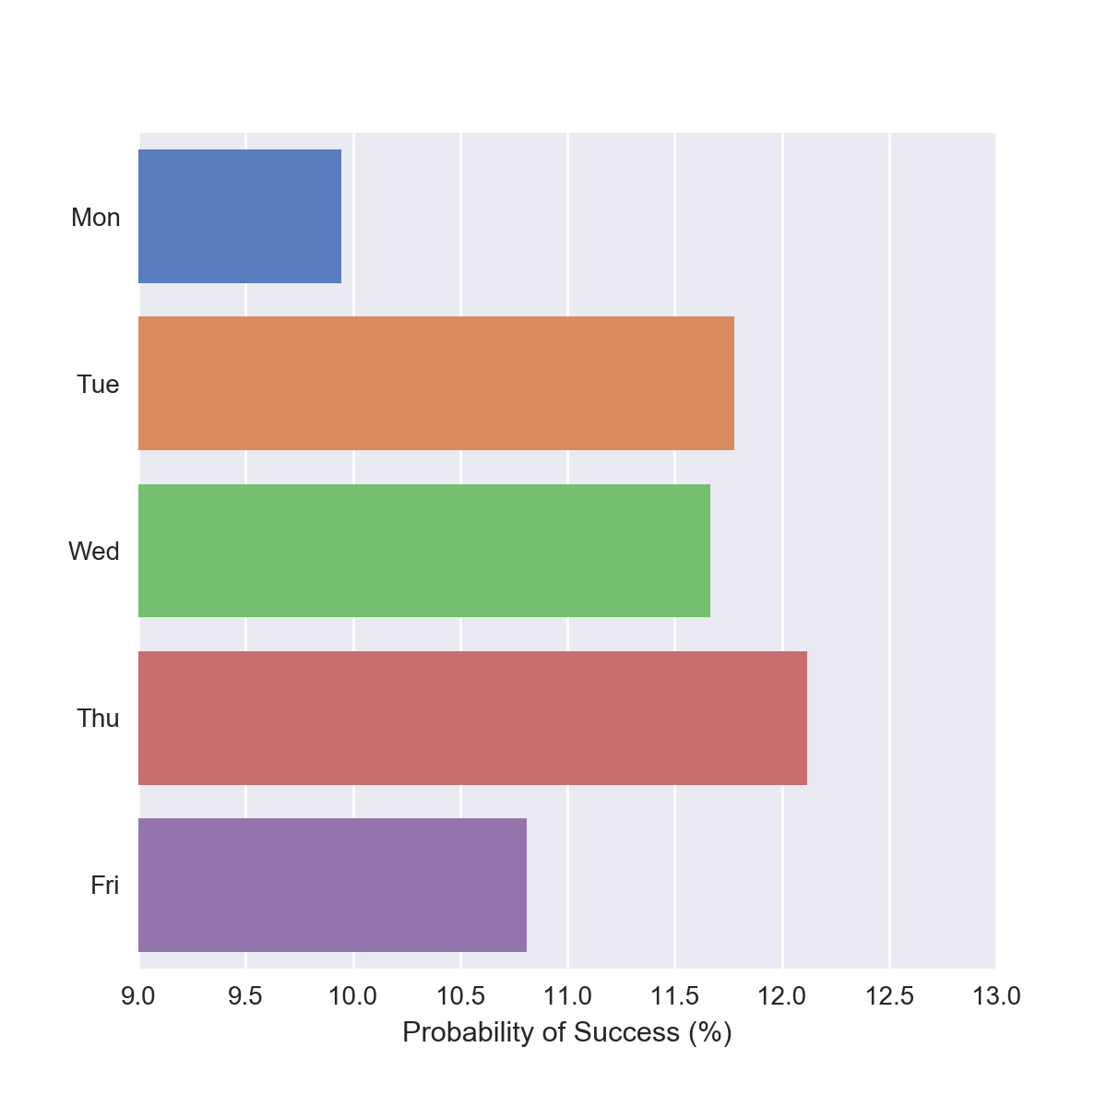
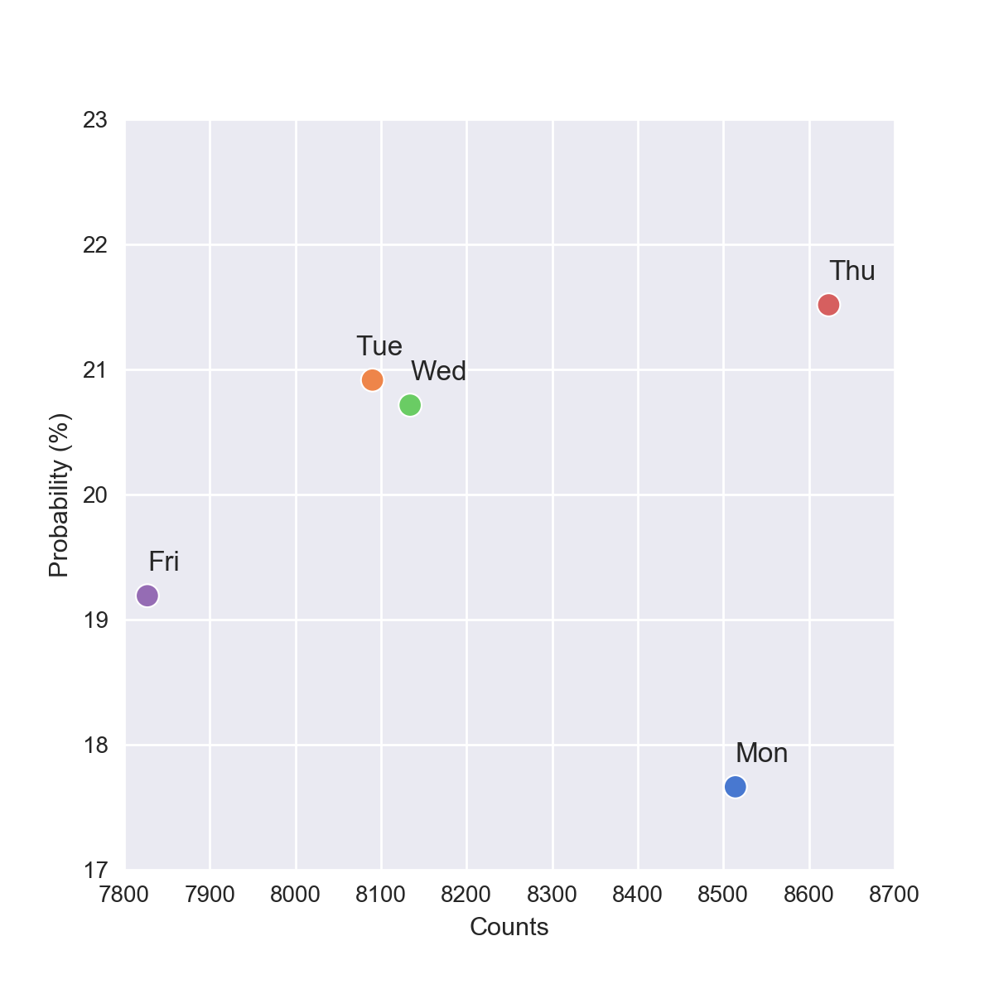
Weekday
Probability of success vs. Number of Calls by Weekday
Probability of Success by Weekday

Slide 23
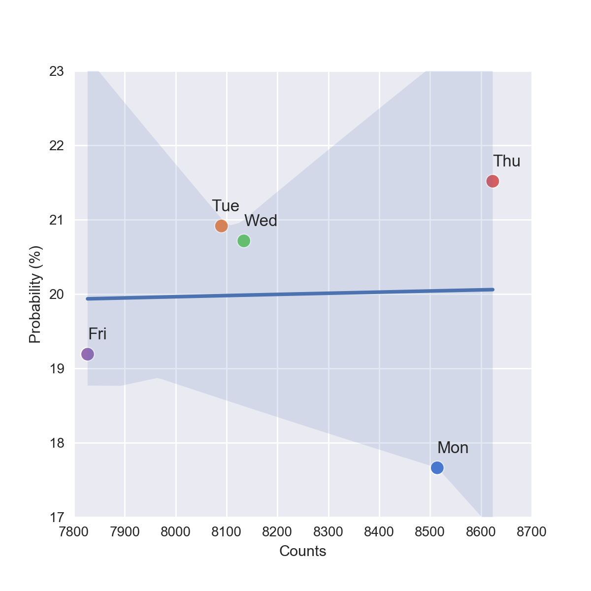
Weekday
Probability of success vs. Number of Calls by Weekday
Probability of Success by Weekday

Slide 24
Weekday
Probability of success vs. Number of Calls by Weekday
Probability of Success by Weekday
Loser
Winner

Slide 25
Age Analysis

Slide 26
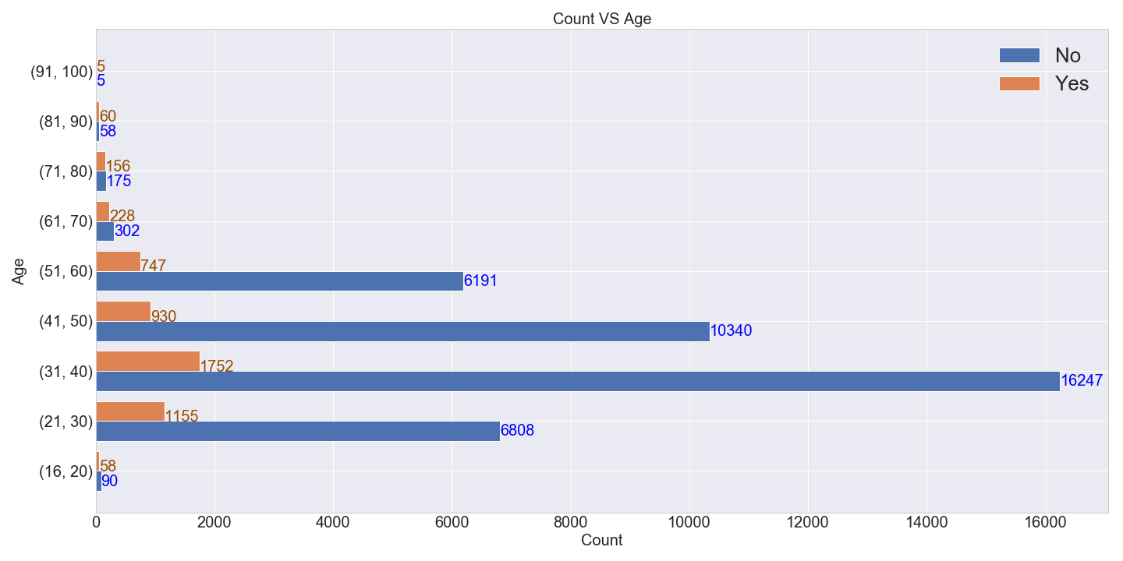
How old our users are Vs Count
Youngest Person: 16
Oldest Person: 98

Slide 27
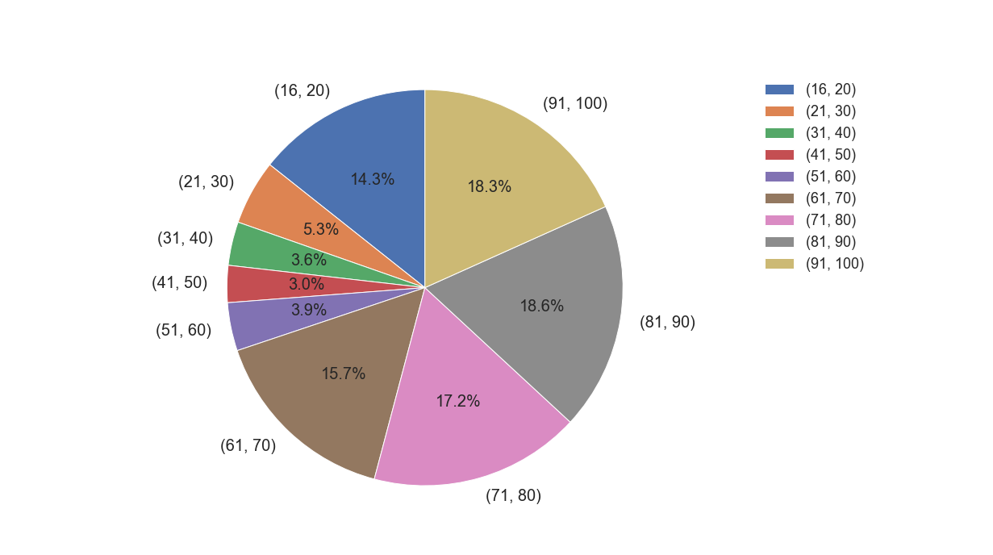
Probability of Success for Ages
Second
First
Third

Slide 28
Feature Importance
with Random Forest

Slide 29
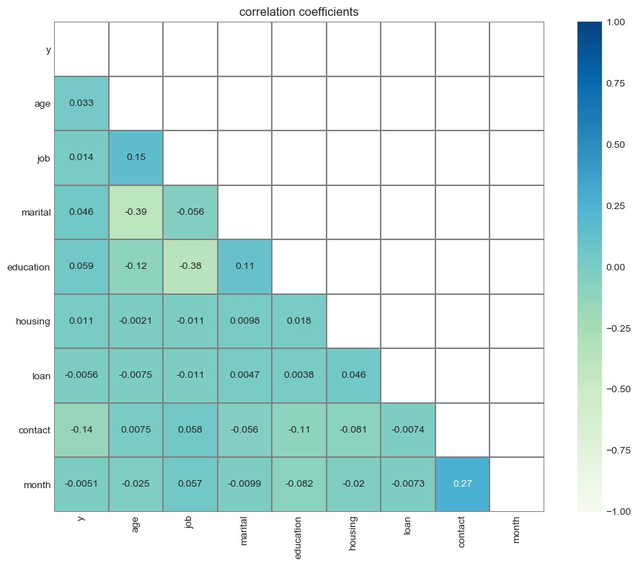
Relation between different features
Lighter - more negatively correlated
Darker - more positively correlated
The correlation between the selected features should be as low as possible

Slide 30
Relation between different features
Some Correlation
Marital status and Age
Job category and Education
Contact type (cellular or landline) and Month

Slide 31
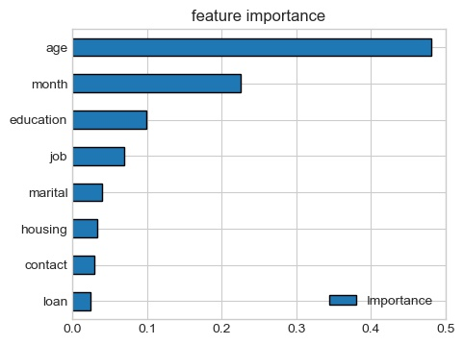
Feature Selection with Random Forest
Relative Feature Importance
Age is most predictive
Marital Status has some predictive importance
Day of the week is lower in importance

Slide 32
Conclusion
Age was the most predictive factor
Age group 61-100
Marital status is weakly correlated with age
Month seems predictive, but is not
Day of the week is less important than other factors

Slide 33
THANK YOU!

Slide 34
References
[1] [Moro et al., 2014] S. Moro, P. Cortez and P. Rita. A Data-Driven Approach to Predict the Success of Bank Telemarketing. Decision Support Systems, Elsevier, 62:22-31, June 2014

